Slide 1
QuickSort Algorithm
Enjy Ramadan Eid 223385

Slide 2
What is quicksort algorithm?
QuickSort is a sorting algorithm based on the Divide and Conquer algorithm that picks an element as a pivot and partitions the given array around the picked pivot by placing the pivot in its correct position in the sorted array.

Slide 3
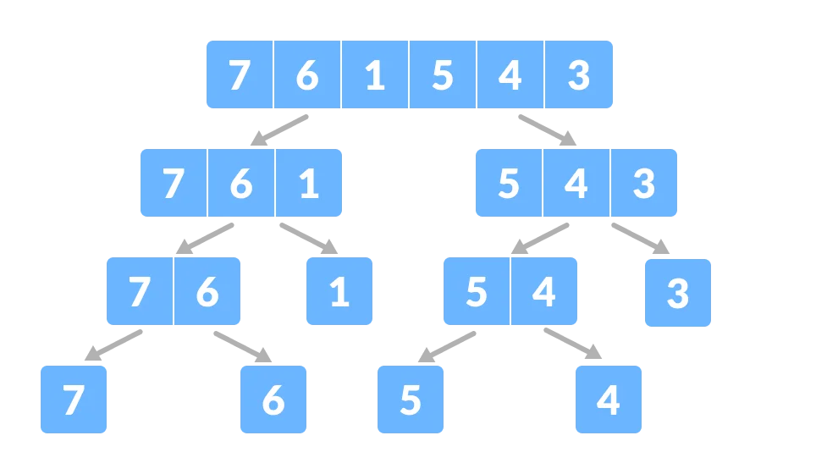
What is Divide and conquer Strategy?
following general plan:
A problem is divided into several subproblems of the same type, ideally of about equal size.
The subproblems are solved typically recursively, though sometimes a different algorithm is employed, especially when subproblems become small enough.
If necessary, the solutions to the subproblems are combined to get a solution
to the original problem.
Visualization

Slide 4
Steps for Quicksort
Partitioning
Quicksort
Use Hoare’s partitioning algorithm.
Use QuickSort algorithm

Slide 5
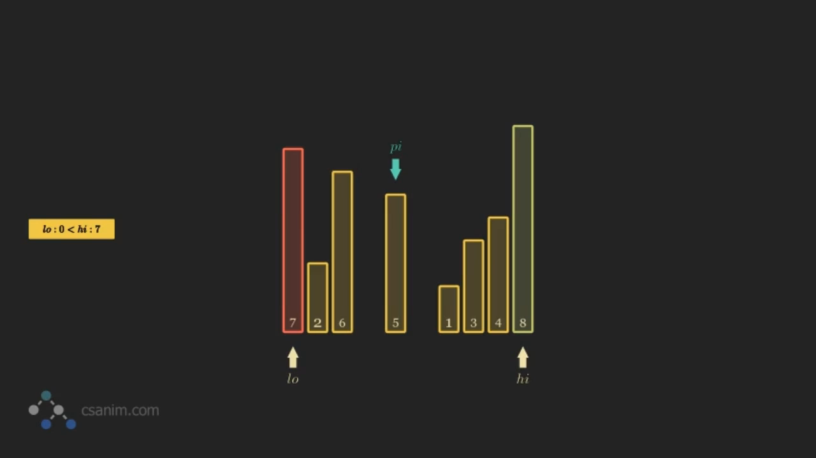
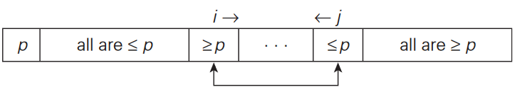
What is Hoare’s partitioning?
Visualization
General idea
works by initializing two indexes that start at two ends, the two indexes move toward each other until an inversion is (A smaller value on the left side and greater value on the right side) found. When an inversion is found, two values are swapped, and the process is repeated.

Slide 6
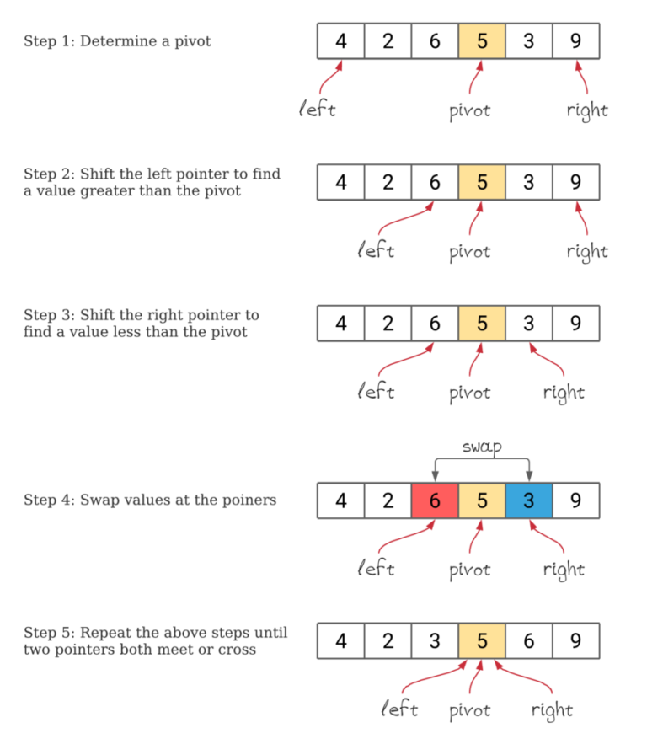
Examples On hoare’s partitioning

Slide 7
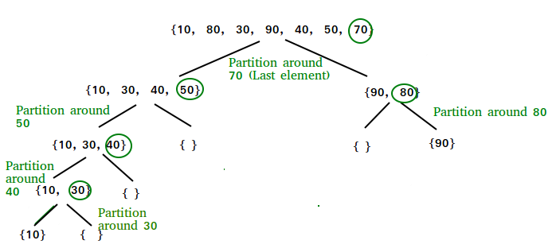
How quicksort works?
General idea
→ The key process in QuickSort is a partition(). The target of partitions is to place the pivot (any element can be chosen to be a pivot) at its correct position in the sorted array and put all smaller elements to the left of the pivot, and all greater elements to the right of the pivot.
→ Partition is done recursively on each side of the pivot after the pivot is placed in its correct position and this finally sorts the array.
Visualization

Slide 8
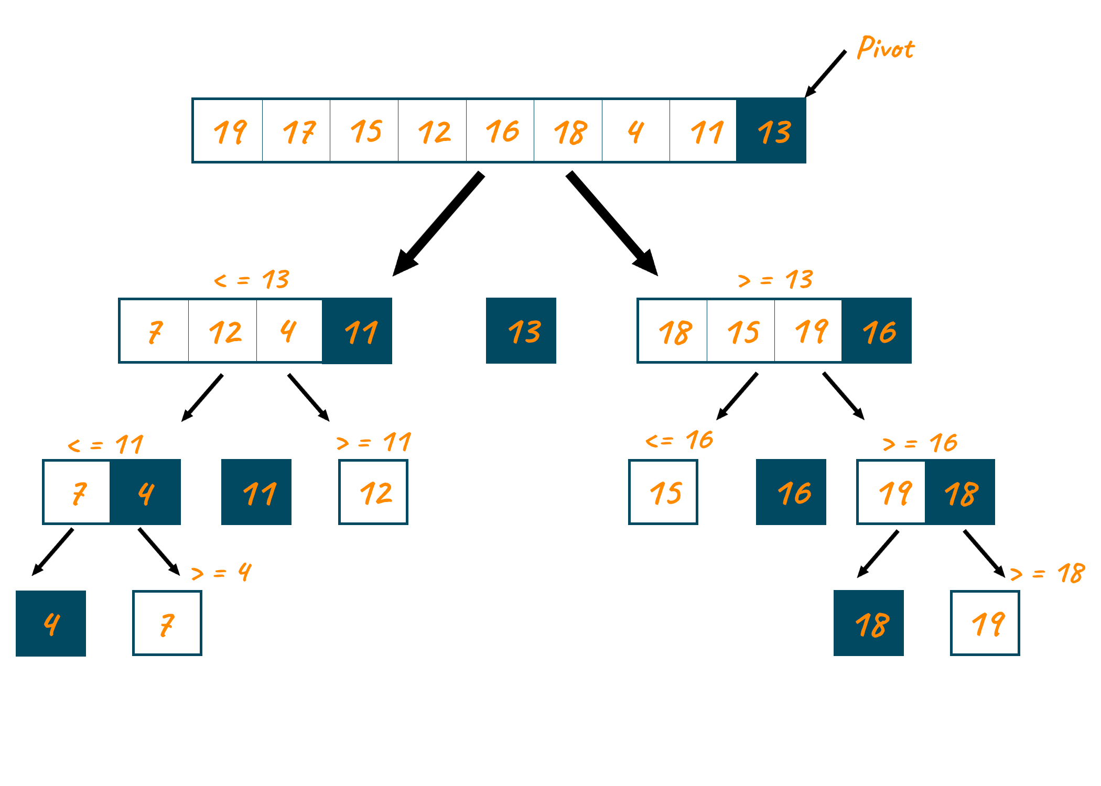
Examples on Quicksort

Slide 9
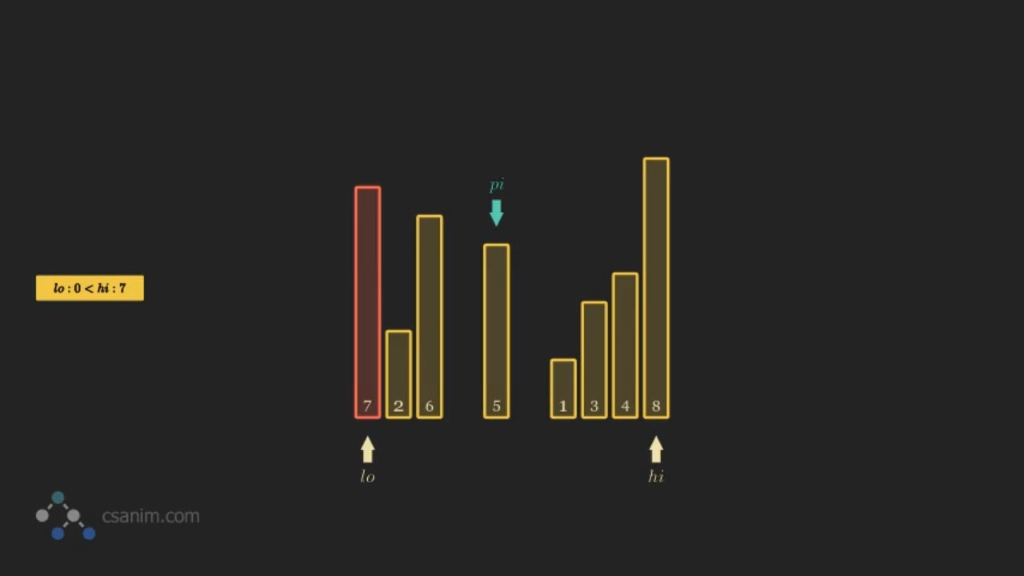
Visualization of Quicksort

Slide 10
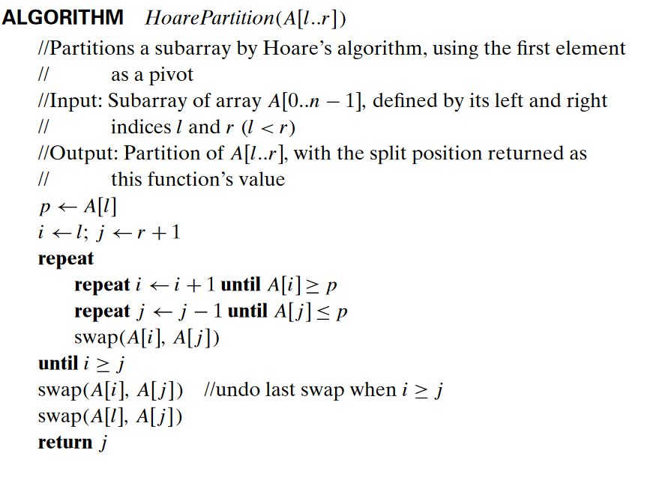
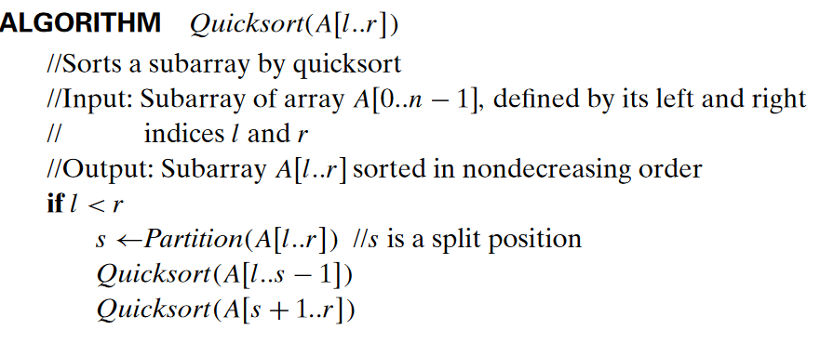
Quicksort code implementation
Step 1: Hoar’s partitioning
Step 2: Quicksort

Slide 11
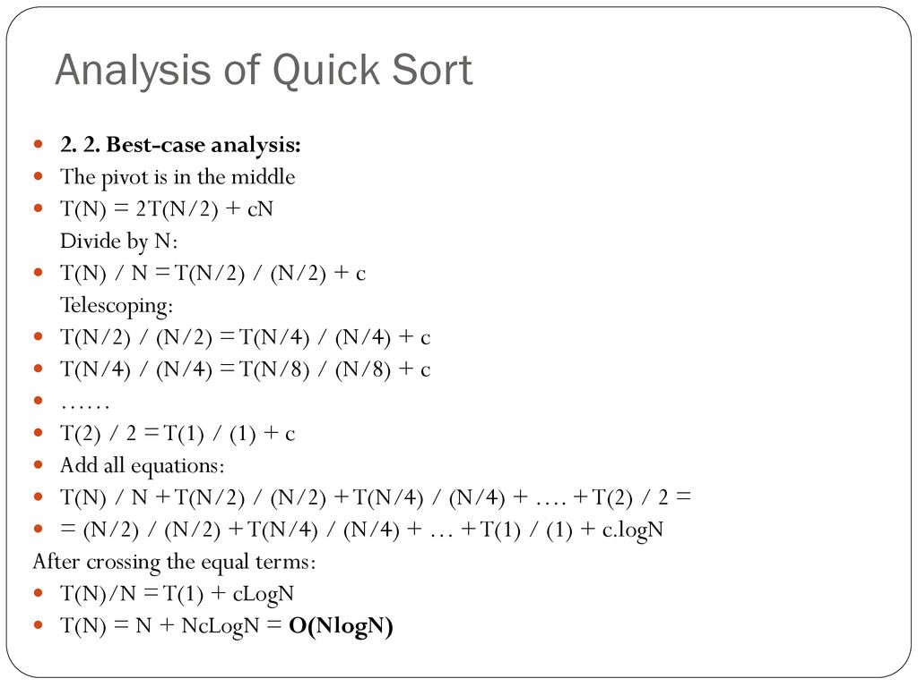
Best Case analysis (pivot is in the middle)

Slide 12
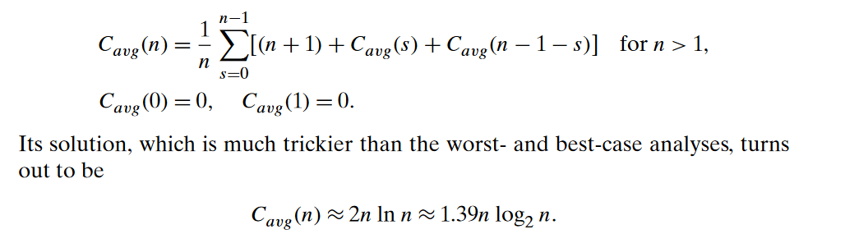
Average Case analysis (Random arrays)

Slide 13
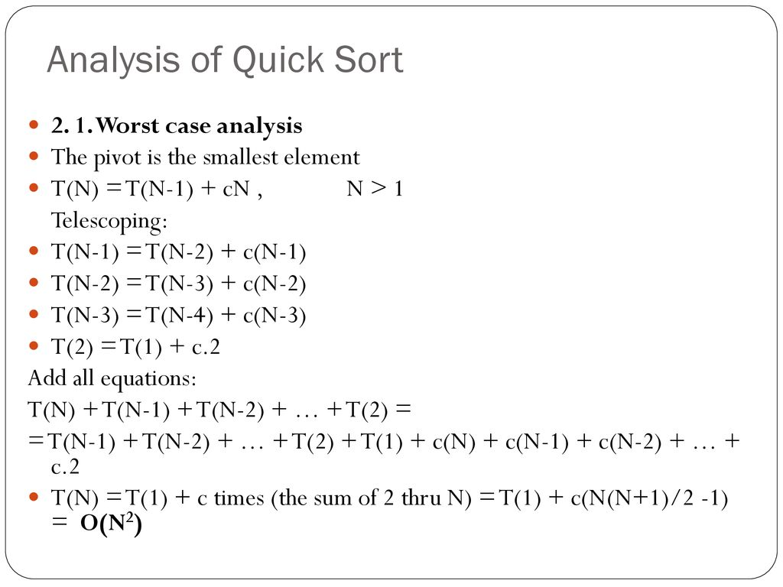
Worst Case analysis (Sorted array)

Slide 14
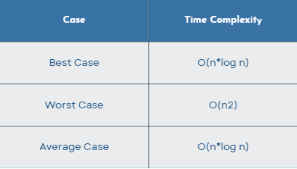
Time complexity analysis for quicksort

Slide 15
THANK YOU
Enjy Ramadan Eid
223385
enjy.ramadan@msa.edu.eg

